Slide 1



Criação de Sites I
Prof. Cândido Farias
E-mail: candido.cimol@gmail.com
Professor: Cândido Farias

Slide 2
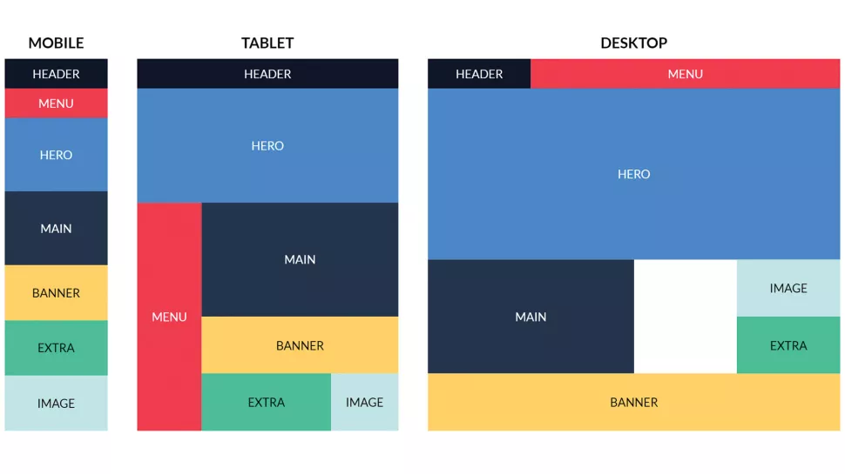
Nesta Aula
Grid Layout
Professor: Cândido Farias

Slide 3

CSS
Grid Layout
Conceito que visa organizar os elementos de uma página HTML dentro de seus containers de forma consistente.
Ideais para o layout de grandes seções do site.
Apresenta um sistema bi-dimencional de grid
Reorganização do conteúdo de acordo com a necessidade
Composto por um conjunto de propriedades
Professor: Cândido Farias

Slide 4
CSS
Grid Layout
Propriedades:
grid-container
display
grid-template-columns
grid-template-rows
justify-content
align-content
Grid-item
grid-column
grid-column
grid-row
grid-area
grid-template-areas
Professor: Cândido Farias

Slide 5
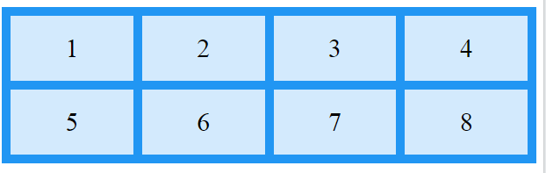
CSS
Grid Layout
Propriedades:
grid-container
display
grid-template-columns
.grid-container {
display: grid;
grid-template-columns: auto auto auto auto;
}
https://www.w3schools.com/css/tryit.asp?filename=trycss_grid_grid-template-columns1
Professor: Cândido Farias

Slide 6
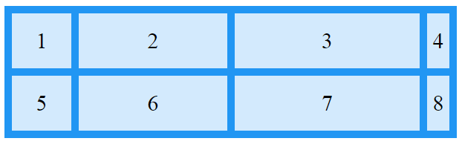
CSS
Grid Layout
Propriedades:
grid-container
display
grid-template-columns
.grid-container {
display: grid;
grid-template-columns: 80px 200px auto 40px;
}
https://www.w3schools.com/css/tryit.asp?filename=trycss_grid_grid-template-columns2
Professor: Cândido Farias

Slide 7
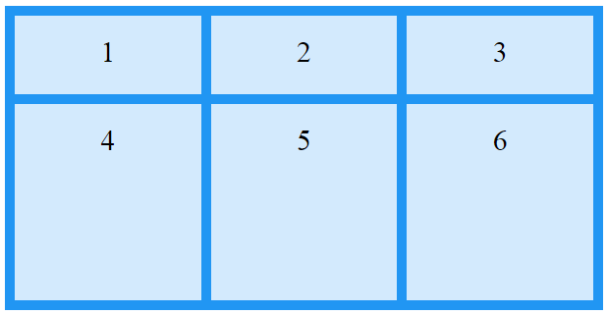
CSS
Grid Layout
Propriedades:
grid-container
display
grid-template-rows
.grid-container {
display: grid;
grid-template-rows: 80px 200px;
}
https://www.w3schools.com/css/tryit.asp?filename=trycss_grid_grid-template-rows
Professor: Cândido Farias

Slide 8
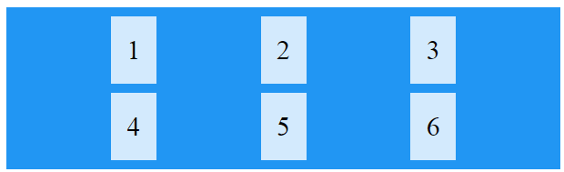
CSS
Grid Layout
Propriedades:
grid-container
display
justify-content
.grid-container {
display: grid;
justify-content: space-evenly;
}
https://www.w3schools.com/css/tryit.asp?filename=trycss_grid_justify-content_space-evenly
Professor: Cândido Farias

Slide 9
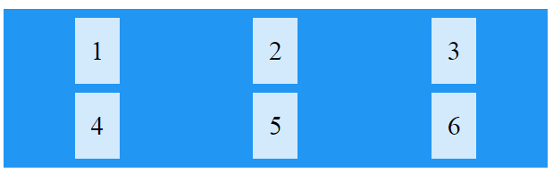
CSS
Grid Layout
Propriedades:
grid-container
display
justify-content
.grid-container {
display: grid;
justify-content: space-around;
}
https://www.w3schools.com/css/tryit.asp?filename=trycss_grid_justify-content_space-around
Professor: Cândido Farias

Slide 10
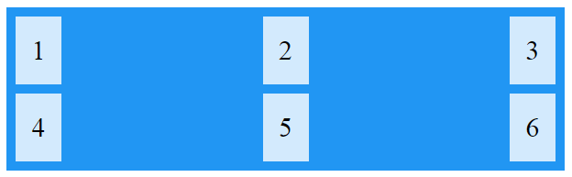
CSS
Grid Layout
Propriedades:
grid-container
display
justify-content
.grid-container {
display: grid;
justify-content: space-between;
}
https://www.w3schools.com/css/tryit.asp?filename=trycss_grid_justify-content_space-between
Professor: Cândido Farias

Slide 11

CSS
Grid Layout
Propriedades:
grid-container
display
justify-content
.grid-container {
display: grid;
justify-content: center;
}
https://www.w3schools.com/css/tryit.asp?filename=trycss_grid_justify-content_center
Professor: Cândido Farias

Slide 12
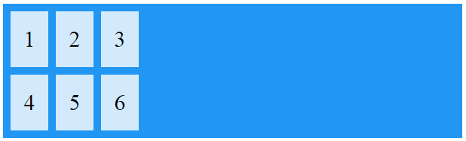
CSS
Grid Layout
Propriedades:
grid-container
display
justify-content
.grid-container {
display: grid;
justify-content: start;
}
https://www.w3schools.com/css/tryit.asp?filename=trycss_grid_justify-content_start
Professor: Cândido Farias

Slide 13
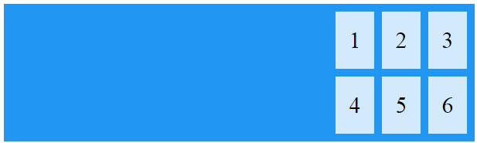
CSS
Grid Layout
Propriedades:
grid-container
display
justify-content
.grid-container {
display: grid;
justify-content: end;
}
https://www.w3schools.com/css/tryit.asp?filename=trycss_grid_justify-content_end
Professor: Cândido Farias

Slide 14
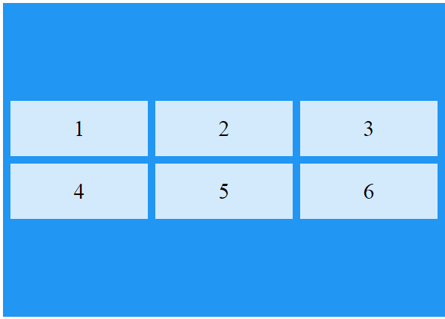
CSS
Grid Layout
Propriedades:
grid-container
display
align-content
.grid-container {
display: grid;
align-content: center;
}
https://www.w3schools.com/css/tryit.asp?filename=trycss_grid_align-content_center
Professor: Cândido Farias

Slide 15
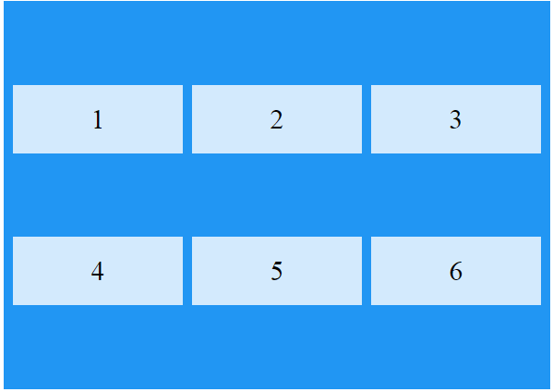
CSS
Grid Layout
Propriedades:
grid-container
display
align-content
.grid-container {
display: grid;
height: 400px;
align-content: space-evenly;
}
https://www.w3schools.com/css/tryit.asp?filename=trycss_grid_align-content_space_evenly
Professor: Cândido Farias

Slide 16
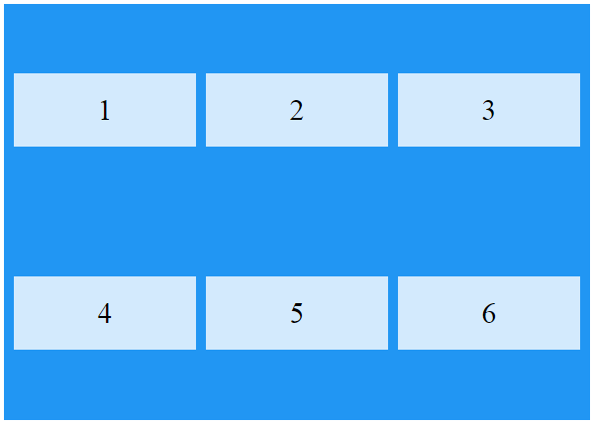
CSS
Grid Layout
Propriedades:
grid-container
display
align-content
.grid-container {
display: grid;
height: 400px;
align-content: space-around;
}
https://www.w3schools.com/css/tryit.asp?filename=trycss_grid_align-content_space_around
Professor: Cândido Farias

Slide 17
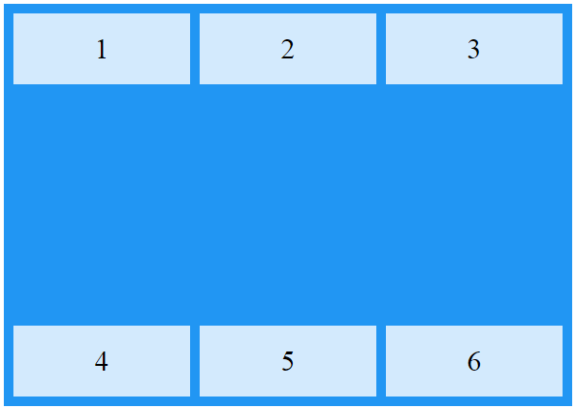
CSS
Grid Layout
Propriedades:
grid-container
display
align-content
.grid-container {
display: grid;
height: 400px;
align-content: space-between;
}
https://www.w3schools.com/css/tryit.asp?filename=trycss_grid_align-content_space_between
Professor: Cândido Farias

Slide 18
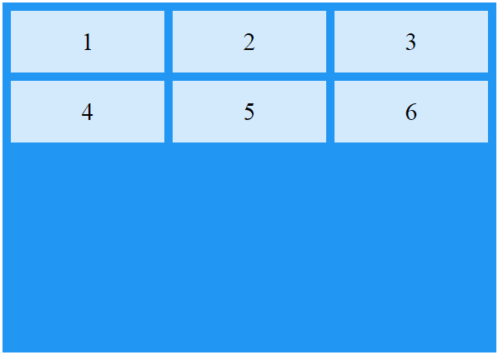
CSS
Grid Layout
Propriedades:
grid-container
display
align-content
.grid-container {
display: grid;
height: 400px;
align-content: start;
}
https://www.w3schools.com/css/tryit.asp?filename=trycss_grid_align-content_start
Professor: Cândido Farias

Slide 19
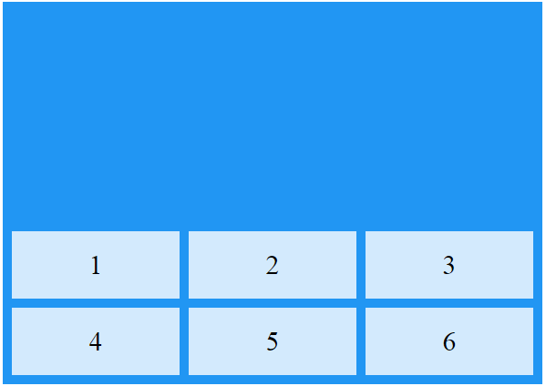
CSS
Grid Layout
Propriedades:
grid-container
display
align-content
.grid-container {
display: grid;
height: 400px;
align-content: end;
}
https://www.w3schools.com/css/tryit.asp?filename=trycss_grid_align-content_end
Professor: Cândido Farias

Slide 20
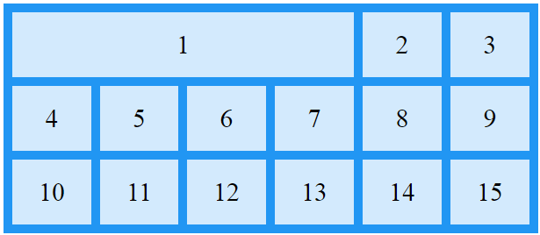
CSS
Grid Layout
Propriedades:
grid-itens
grid-column
.item1 {
grid-column: 1 / 5;
}
https://www.w3schools.com/css/tryit.asp?filename=trycss_grid_grid-column_line
Professor: Cândido Farias

Slide 21
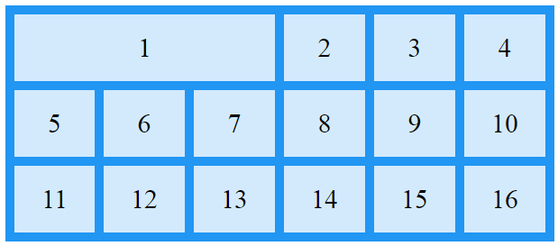
CSS
Grid Layout
Propriedades:
grid-itens
grid-column
.item1 {
grid-column: 1 / span 3;
}
https://www.w3schools.com/css/tryit.asp?filename=trycss_grid_grid-column
Professor: Cândido Farias

Slide 22
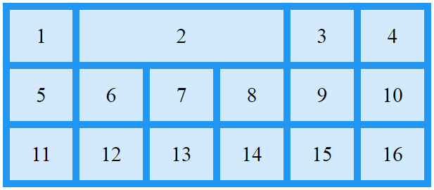
CSS
Grid Layout
Propriedades:
grid-itens
grid-column
.item2 {
grid-column: 2 / span 3;
}
https://www.w3schools.com/css/tryit.asp?filename=trycss_grid_grid-column2
Professor: Cândido Farias

Slide 23
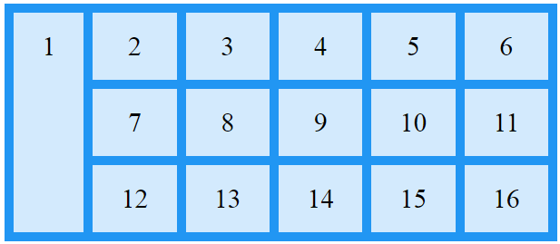
CSS
Grid Layout
Propriedades:
grid-itens
grid-row
.item1 {
grid-row: 1 / 4;
}
https://www.w3schools.com/css/tryit.asp?filename=trycss_grid_grid-row1
Professor: Cândido Farias

Slide 24
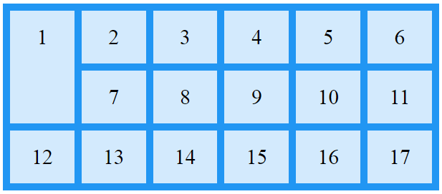
CSS
Grid Layout
Propriedades:
grid-itens
grid-row
.item1 {
grid-row: 1 / span 2;
}
https://www.w3schools.com/css/tryit.asp?filename=trycss_grid_grid-row2
Professor: Cândido Farias

Slide 25
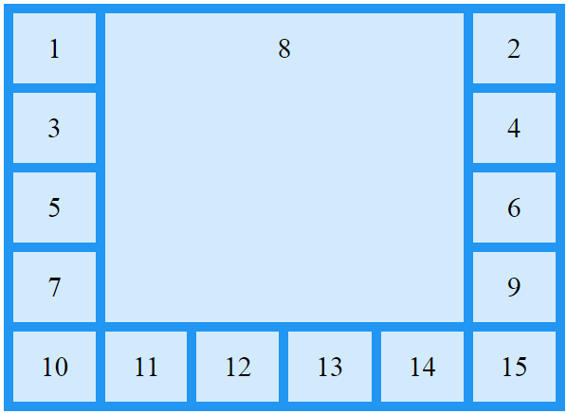
CSS
Grid Layout
Propriedades:
grid-itens
grid-area
.item8 {
grid-area: 1 / 2 / 5 / 6;
}
https://www.w3schools.com/css/tryit.asp?filename=trycss_grid_grid-area1
Professor: Cândido Farias

Slide 26
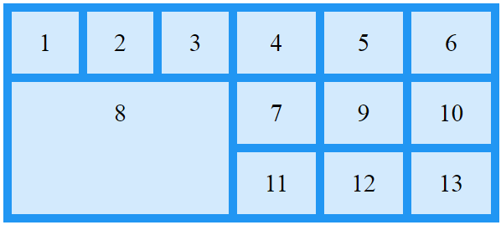
CSS
Grid Layout
Propriedades:
grid-itens
grid-area
.item8 {
grid-area: 2 / 1 / span 2 / span 3;
}
https://www.w3schools.com/css/tryit.asp?filename=trycss_grid_grid-area2
Professor: Cândido Farias

Slide 27
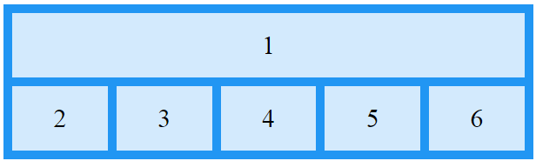
CSS
Grid Layout
Propriedades:
grid-itens
grid-area
.item1 {
grid-area: myArea;
}
.grid-container {
grid-template-areas: 'myArea myArea myArea myArea myArea';
}
https://www.w3schools.com/css/tryit.asp?filename=trycss_grid_grid-area_named
Professor: Cândido Farias

Slide 28
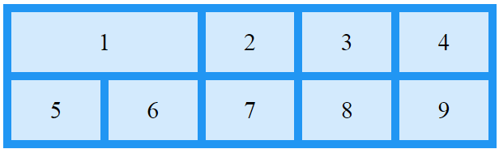
CSS
Grid Layout
Propriedades:
grid-itens
grid-area
.item1 {
grid-area: myArea;
}
.grid-container {
grid-template-areas: 'myArea myArea . . .';
}
https://www.w3schools.com/css/tryit.asp?filename=trycss_grid_grid-area_named1
Professor: Cândido Farias

Slide 29
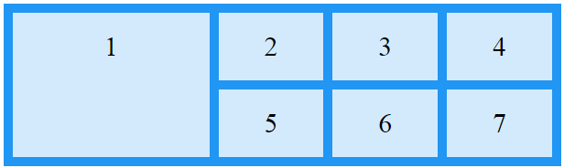
CSS
Grid Layout
Propriedades:
grid-itens
grid-area
.grid-container {
grid-template-areas: 'myArea myArea . . .' 'myArea myArea . . .';
}
https://www.w3schools.com/css/tryit.asp?filename=trycss_grid_grid-area_named2
Professor: Cândido Farias

Slide 30
CSS
Grid Layout
Propriedades:
grid-itens
grid-area
grid-container {
grid-template-areas:
'header header header header header header'
'menu main main main right right'
'menu footer footer footer footer footer';
}
.item1 { grid-area: header; }
.item2 { grid-area: menu; }
.item3 { grid-area: main; }
.item4 { grid-area: right; }
.item5 { grid-area: footer; }
Professor: Cândido Farias

Slide 31
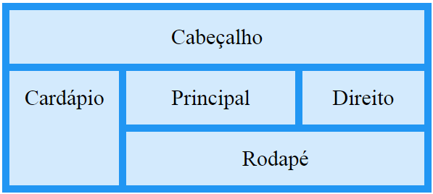
CSS
Grid Layout
Propriedades:
grid-itens
grid-area
https://www.w3schools.com/css/tryit.asp?filename=trycss_grid_grid-area_named3
Professor: Cândido Farias

